Slide 1
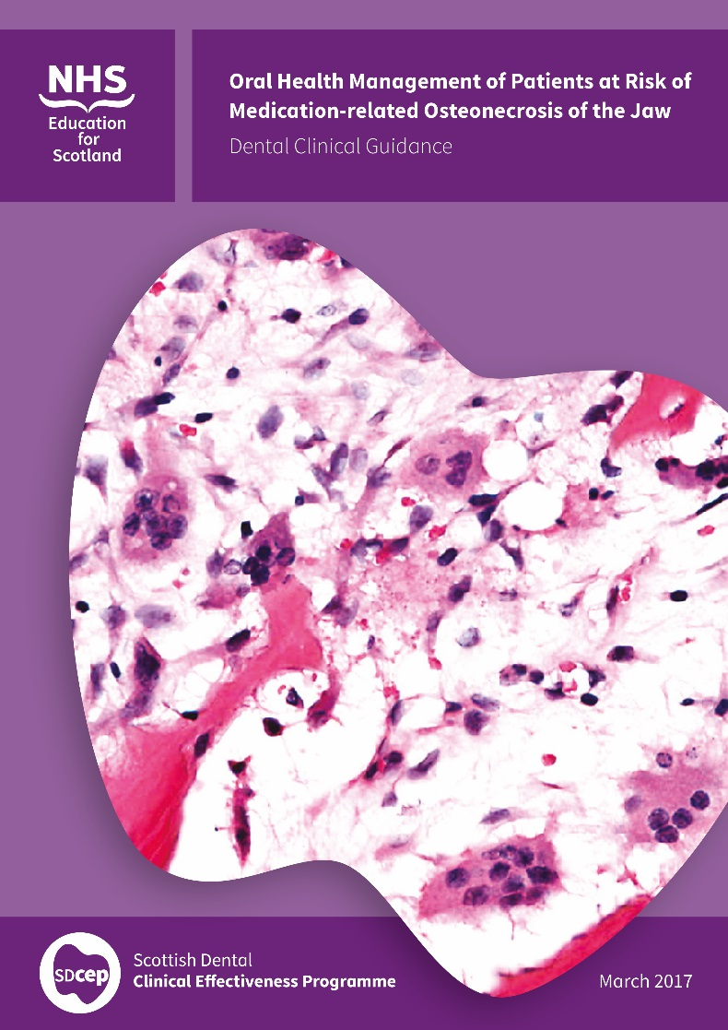
Published March 2017
Oral Health Management of Patients at Risk of Medication-related Osteonecrosis of the Jaw

Slide 2
What is SDCEP?
The Scottish Dental Clinical Effectiveness Programme (SDCEP) is part of the Dental Directorate within NHS Education for Scotland
SDCEP develops guidance on priority topics for oral health care that aims to be evidence-based, practical and user friendly to support quality care
SDCEP guidance informs under-graduate and post-graduate education and training as well as daily dental practice in Scotland and beyond
SDCEP is also involved in implementation research to understand how to bring about changes in practice

Slide 3
Background to the Guidance
Patients who are taking anti-resorptive or anti-angiogenic drugs have a small risk of developing medication-related osteonecrosis of the jaw (MRONJ). This condition may be more prevalent in patients who have dental procedures which impact on bone, for example extractions.
Dental practitioners are likely to see patients who are taking these drugs in primary care as they are prescribed to prevent, as well as to treat, a wide variety of medical conditions.
This guidance aims to help minimise the risk of MRONJ developing in these patients and to encourage a consistent approach to their oral health management.
This guidance is an update to the SDCEP Oral Health Management of Patients Prescribed Bisphosphonates guidance

Slide 4
How was the guidance produced?
A Guidance Development Group (GDG), comprising a group of dental and medical professionals with a particular interest in this topic plus two patient representatives, was convened to write the guidance
SDCEP Research Lead facilitated evidence search and appraisal
Recommendations based on considered judgement of the evidence
Full public consultation and peer review before publication

Slide 5

NICE Accreditation
NICE has accredited the process used by the Scottish Dental Clinical Effectiveness Programme to produce its Oral Health Management of Patients at Risk of Medication-related Osteonecrosis of the Jaw guidance.
Accreditation is valid for 5 years from 15 March 2016. More information on accreditation can be viewed at www.nice.org.uk/accreditation.

Slide 6
Format
The guidance provides evidence-based recommendations in the following areas:
Classification of Patient Risk
Initial Management of Patients at Risk of MRONJ
Ongoing Management of Patients at Risk of MRONJ
Key recommendations are highlighted at the beginning of each section with brief summaries of the evidence underpinning the guidance recommendations throughout the text.
A more in-depth discussion of the evidence is provided in a separate Guidance Development Methodology document.

Slide 7
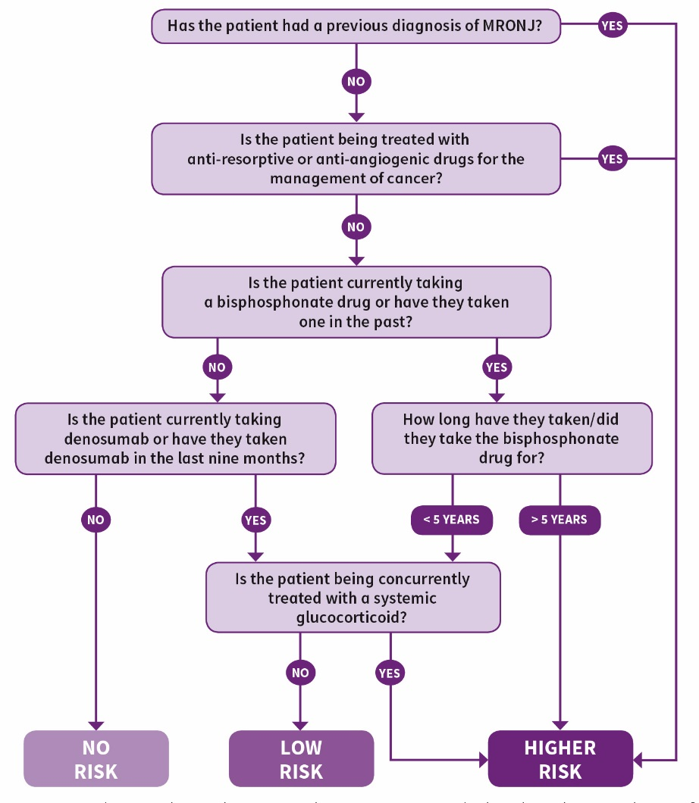
Classification of Patient Risk
Assess whether a patient taking anti-resorptive or anti-angiogenic drugs is at low risk or higher risk of developing MRONJ based on their medical condition, type and duration of drug therapy and any other complicating factors and record this in the patient’s clinical notes

Slide 8
Initial Management of Patients at Risk of MRONJ
Before commencement of anti-resorptive or anti-angiogenic drug therapy, or as soon as possible thereafter, aim to get the patient as dentally fit as feasible, prioritising preventive care.
Higher risk cancer patients should preferably undergo a thorough dental assessment, with remedial dental treatment where required, prior to commencement of the drug therapy.
Advise the patient that, due to the medication they are taking, there may be a risk of developing MRONJ but ensure that they understand that the risk is small.
Ensure that the patient is not discouraged from taking their medication or from undergoing dental treatment. Record that this advice has been given.

Slide 9
Initial Management of Patients at Risk of MRONJ
Give personalised preventive advice to help the patient optimise their oral health.
Prioritise care that will reduce mucosal trauma or may help avoid future extractions or any oral surgery or procedures that may impact on bone.
For medically complex patients for whom you would normally seek advice, including higher risk patients who are being treated with anti-resorptive or anti-angiogenic drugs for the management of cancer, consider consulting a specialist with regards to clinical assessment and treatment planning.

Slide 10
Continuing Management of Patients at Risk of MRONJ
Carry out all routine dental treatment as normal and continue to provide personalised preventive advice in primary care.
Perform straightforward extractions and other bone-impacting treatments in low risk patients in primary care.
Adopt a more conservative approach in higher risk patients, giving greater consideration to other, less invasive alternative treatment options before performing extractions and other bone-impacting treatments in primary care.

Slide 11
Continuing Management of Patients at Risk of MRONJ
Do not prescribe antibiotic or antiseptic prophylaxis following extractions or other bone-impacting treatments specifically to reduce the risk of MRONJ.
Review healing. If the extraction socket is not healed at 8 weeks, and you suspect that the patient has MRONJ, refer to a specialist as per local protocols.
If you suspect a patient has spontaneous MRONJ, refer to a specialist as per local protocols.

Slide 12
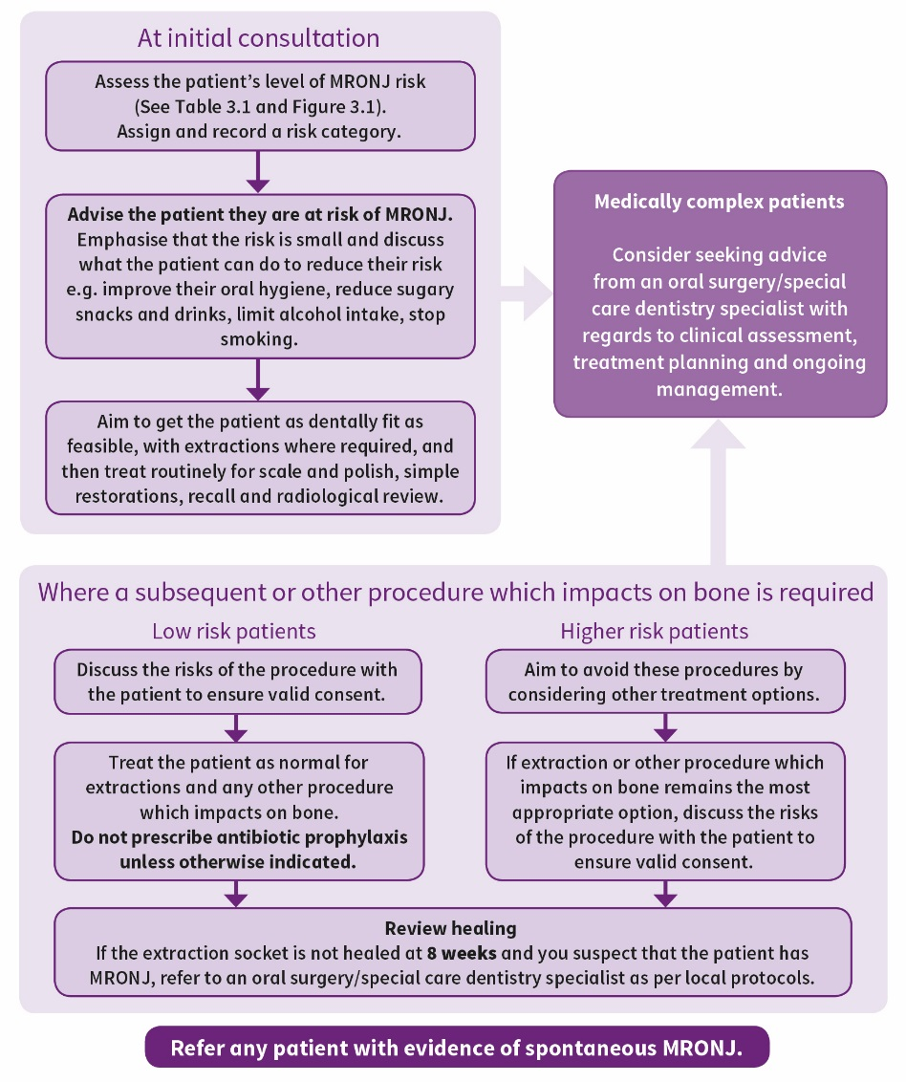
Oral Health Management of Patients at Risk of MRONJ
Where a patient initially presents with an established history of anti-resorptive or anti-angiogenic drug use, follow the advice for extractions or other procedures which impact on bone in the lower section.

Slide 13
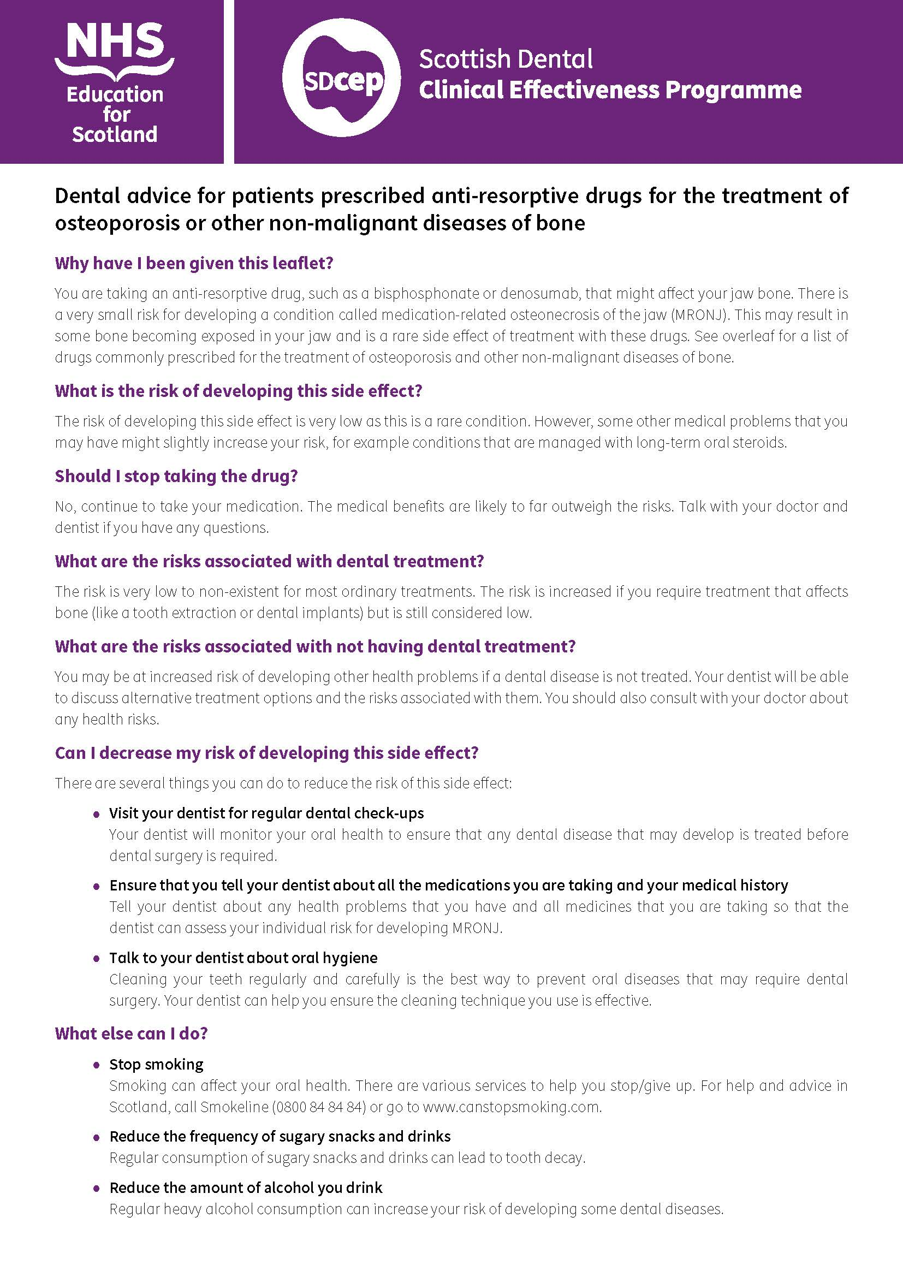
Supporting Tools
Guidance in Brief – a summary of the main recommendations for the busy practitioner
Recommendations for Prescribers and Dispensers
Patient leaflets – for patients with osteoporosis/non-malignant diseases of bone and for cancer patients
Accessible versions

Slide 14
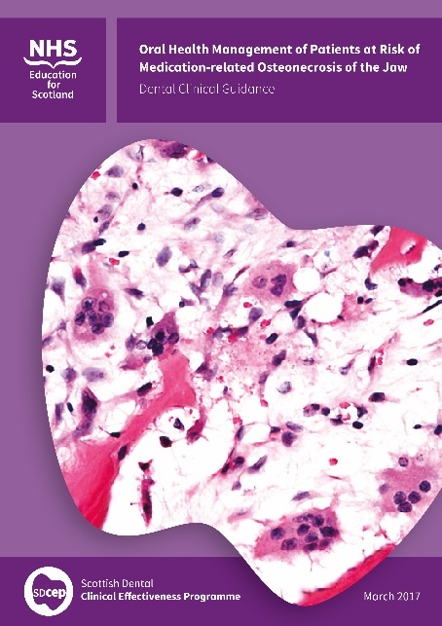

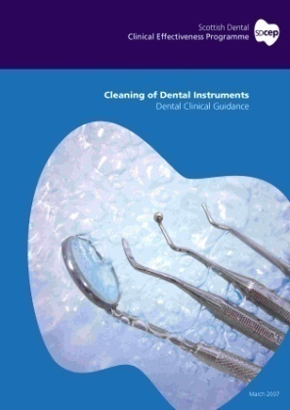
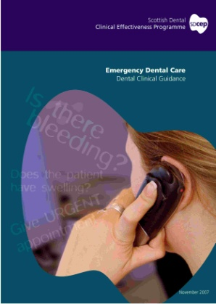

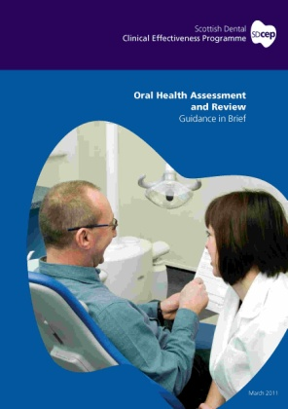
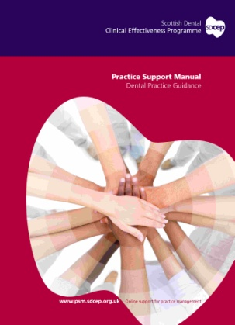
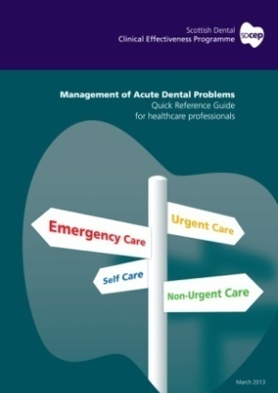
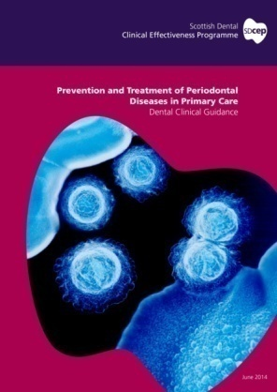
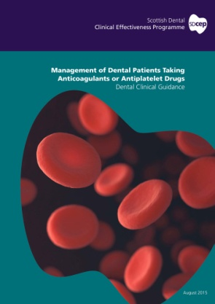
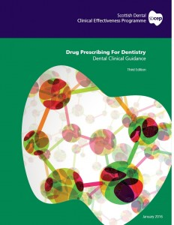
More Information
The full guidance, Guidance in Brief and Supporting Tools are available via the SDCEP website
www.sdcep.org.uk
For further information contact SDCEP at
scottishdental.cep@nes.scot.nhs.uk
Other SDCEP guidance publications are also available via the SDCEP website

